Slide 1
Scientific Computing with C++
C++ is the most heavily used language in science and professional programming – for large scale projects
All major modern operating systems are written in C++ including Windows, Linux, Android, MacOS & iOS
You should always know the language of your operating system – like you should always know the architecture & assembly language of the CPU you are using
GPU coding (nVidia, Radeon, etc) is all done using C++
All major video games are written in C++
BNL uses C++ and Python almost exclusively

Slide 2
Useful C++ Reference Sites
https://isocpp.org (ISO Committee)
http://en.cppreference.com/w
http://www.cplusplus.com/doc/tutorial
http://c-faq.com
http://www.cprogramming.com
What you should know about C++11
The standard way of converting between numbers and strings in C++11

Slide 3
Reasonable Expectations
It takes 500 hours to become an expert beginner at anything
Consider playing quality: Junior High Band vs. High School Band
7 & 8th grade: 5 hrs/week = ~250 hrs/yr * 2 yrs = 500 hours
We will spend only 90 hours together: ~1/5th of the required time
We all learned how to read before we learned how to write
A blank computer screen is too intimidating for new programmers
We don’t recommend always “starting from scratch”
Many junior BNL staff inherit existing code to fix or extend
As a total novice, we learn even when we just retype other’s code

Slide 4
Reasonable Expectations
Programming is a very precise science – it metes swift frustration for the slightest inattention to details
There is never just one way to solve a problem – variability is an unsettling but necessary complication
Sometimes the only way to learn is to sit there and cry about it – everyone bumps their head along the way
Lab exercises are taken directly from active research projects at BNL
Greatly simplified mathematics, but hopefully retain the essence of the underlying approach and motivation of the researchers
Take away some of the mystery but none of the marvel

Slide 5
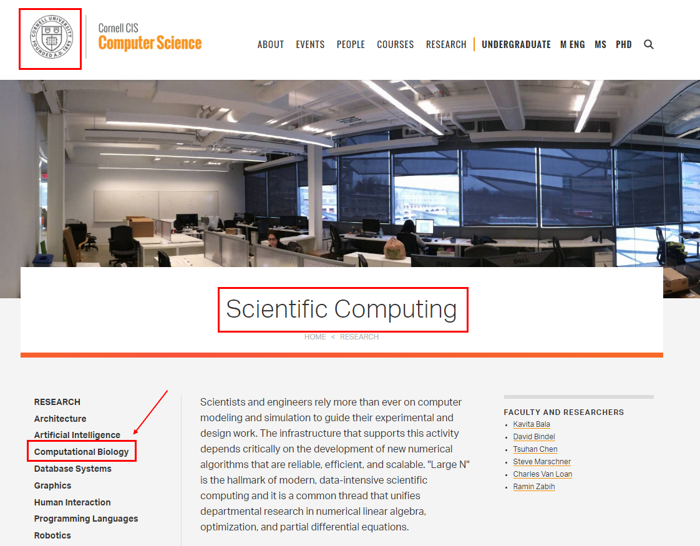
An Degree in Scientific Computing

Slide 6
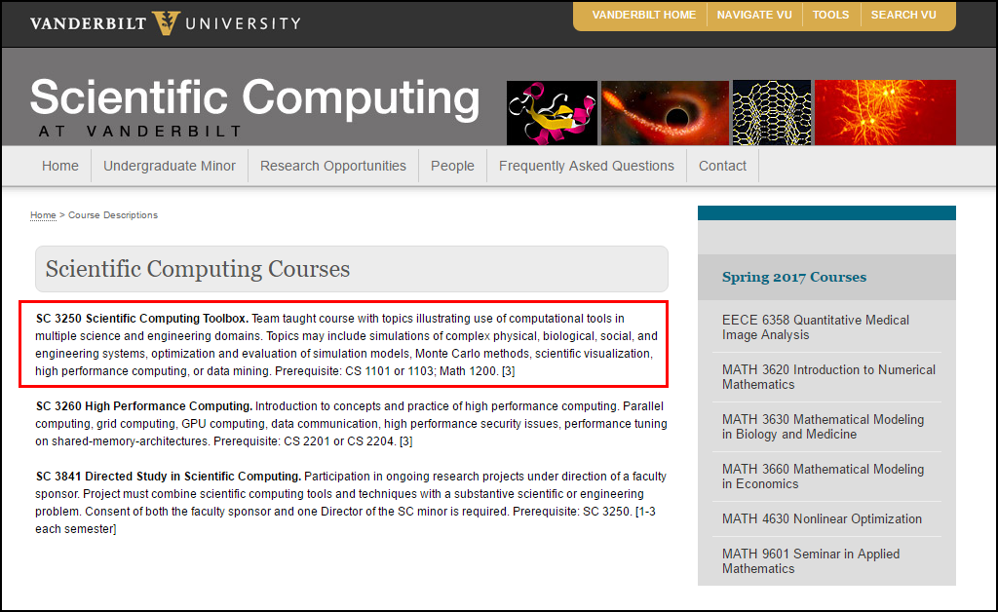
An Degree in Scientific Computing

Slide 7
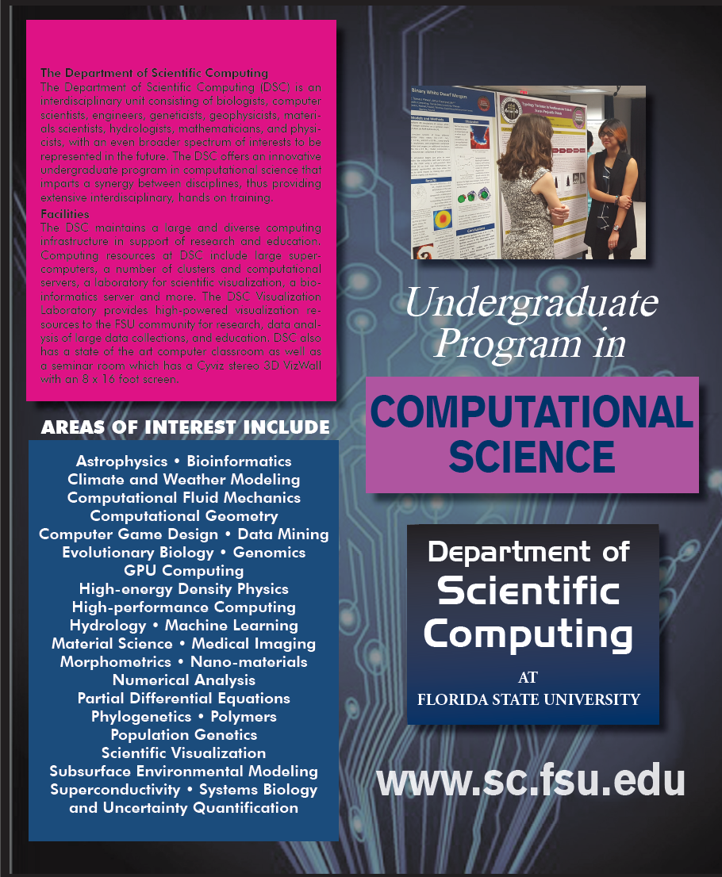
An Degree in Scientific Computing
The Department of Scientific Computing (DSC) is an interdisciplinary unit consisting of biologists, computer scientists, engineers, geneticists, geophysicists, materials scientists, hydrologists, mathematicians, and physicists. The DSC offers an innovative undergraduate degree in scientific computing that imparts a synergy between disciplines, thus providing extensive interdisciplinary, hands on training.

Slide 8
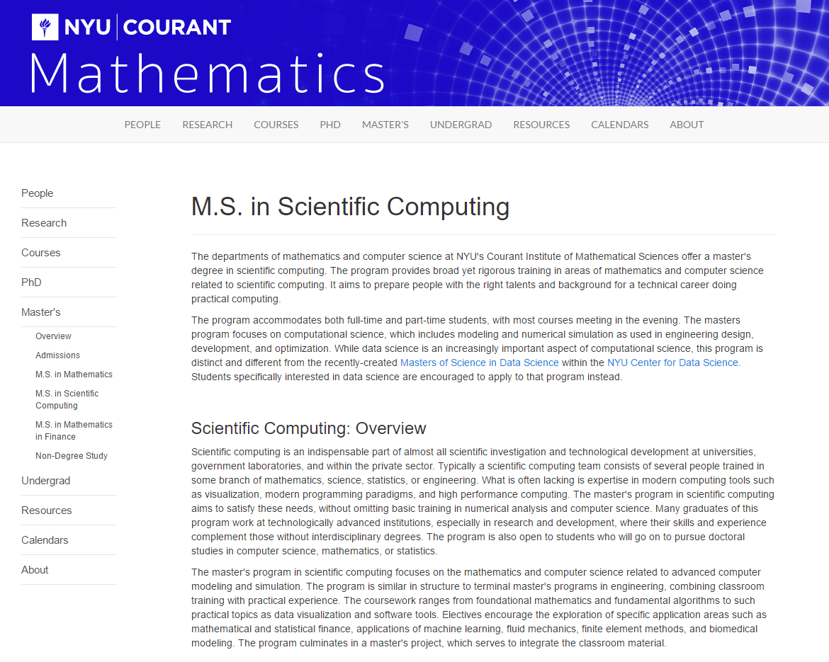
An Degree in Scientific Computing

Slide 9

An Degree in Scientific Computing
Mathematics
Data Pipelining
Data Formats & Translations
Cross Platform Application Integration
Live Smooth Streaming & Caching
Parallel Data Structures & Algorithms
GPU Computing
Many Core (Xeon Phi)
Cluster / Grid Deployments
Applied Linear Algebra
Probability & Statistics
Calculus (Integral)
Differential Equations
Discrete Mathematics
Complex Analysis
Computer Science
Internet Technologies
Numerical Methods

Slide 10
A Degree in Scientific Computing
Data Visualization
Multidimensional & Multi-temporal
Machine Learning & Data Mining
Integrated Collaboration
Managing Massive Data Sets
Real Time Big Data Search & Classification
Encoding, Compression, Transport
Reporting & Archiving
Modelling and Simulation
Large-Scale Nature-Inspired & Hybrid Evolutionary
Highly Non-Linear Transient Systems
Shape-Preserving Response Prediction

Slide 11
Key Points
Every science research project can benefit from even a touch of scientific computing
Better statistics & data visualization on posters
Compelling analysis from modelling & simulation
Novel integration of computation is a big differentiator!
Experimental Computational Mathematics (ECM) is a thing
Experiments don’t necessarily require lab equipment
Nowadays profound insights come only from extended analysis

Slide 12
Key Points
It does not take thousands of lines of code to keep importance science moving right along…
You don’t have to be a professional programmer or know all the arcane aspects of computer languages
The closer you get to cutting edge science, the less likely you’ll be able to just “download an app” to accomplish what you need
If you don’t know how to code…
You will at some point start to subconsciously limit the types of analysis you can perform because you will remain at the mercy of the available software
Should software shape your science, or instead, will you shape software to advance your science?

